Slide 1
EEG Based Imagined Speech Detection
EE305 - DESIGN LAB

Slide 2
Brain Computer Interference (BCI)
BCI is direct communication pathway between brain’s electrical signals and an external device.
It can be of three types Invasive, Partially Invasive and non – Invasive.
Invasive BCI requires surgery to implant electrodes under scalp, although this method provides good signal to noise ratio (SNR) but the formation of a scar tissue over the device due to reaction to the extraneous matter can make a permanent hole in the skull.
Partial Invasive BCI in which electrode arrays are implanted over the brain inside the skull, this method overcomes the problem of formation a scar tissue even though the signal strength is weak. Example, Electrocorticography (ECoG).
Non-invasive techniques are the most widely used with Electroencephalography (EEG) as most commonly acceptable neuroimaging technique.

Slide 3
Electroencephalogram (EEG) Signal
The brain produces a continuous output of small electrical signals, often referred to as brain waves. The recording of these signals, called electroencephalogram (EEG), is the summation of all the postsynaptic potentials of the neurons in the cerebral cortex. The electrodes that pick up these signals are attached to the surface of the scalp.
The amplitudes of these signals are in microvolts. The signals are then amplified are then recorded with an electroencephalograph, which is a device for recording brain waves. The recorded EEG has a frequency somewhere within the 0.01 Hz – 100 Hz range.
The advantage of EEG neuroimaging method includes high temporal resolution, portability, low cost, safer or low risks to the users.

Slide 4
Imagined Speech Decoding System
Imagined speech or covert speech is the ability to produce representation of inner speech without any outside speech stimuli.
Speech imagery is more convenient and intuitive for users.
General Overview of imagined speech decoding and classification
Input Data
Pre-Processing
Feature Extraction
Classification
Performance Analysis

Slide 5
Data Acquisition
It is a process of collection and recording of neural data from the subjects participated in an experiment.
Types of Recording Techniques:
Based on the imagined part:
Word imagination (hello, help)
Syllable imagination (silent: si)
Vowel imagination (a, e, i, o, u)
Based on how words are imagined:
Imagining hearing the words
Imagining speaking the words
Imagining viewing the words

Slide 6
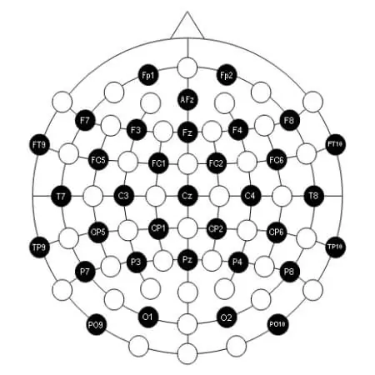
A multichannel EEG sets contain up to 128 or 256 active electrodes. These electrodes are made of silver chloride (AgCl). EEG signal is measured as the potential difference over time, between the active electrode and the reference electrode.
These electrodes are placed over the scalp in the international 10-20 system.

Slide 7
Pre-Processing
To improve the efficiency of a classifier and to reduce computational complexity, the data needs to be preprocessed to eliminate artifacts and noise in the data.
These artifacts include heart beat artifacts (ECG), eye blinks (EOG), muscle movements (EMG), skin resistance, caused by electrode faults, power line, and interference from equipment’s and devices.
In addition, the EEG signal has a low SNR, therefore it is highly important to preprocess the data which involves the process such as down sampling, windowing, and filtering.

